Slide 1
Modulation Demodulation
Notes:
Let’s start with PSTN Introduction..By the way PSTN stands for Public switch telephone network

Slide 2
Objectives
At the end of this session, you will be able to:
  Understand the need and process of modulation/demodulation
  Understand difference between analogue and digital modulation techniques
  Understand analogue modulation techniques called AM, FM along with applications
  Understand digital modulation techniques called ASK, FSK and PSK and their variants along with applications
  Understand the functionality of MODEM

Slide 3
Agenda
Need of modulation
Concept of Modulation
Modulation Techniques in Analog and Digital domain
AM, FM
ASK, FSK and PSK
Modem

Slide 4
Carrier and Modulation
Carrier
  Carriers are exclusively analog in nature
  Generally of high frequency
Modulation
  Process of changing one of the characteristics of carrier wave viz. amplitude or frequency or phase in proportion to amplitude of the input wave is called ‘Modulation’ process.
Notes:
Modulation Means of controlling the characteristics of a signal in a desired way.
Carrier signal A high frequency signal used for digital-to-analog or analog-to-analog modulation. One of the characteristics of the carrier signal (amplitude, frequency or phase) is changed according to the modulating data.
In analog signal, the sending device produces a high frequency signl that acts as a basis for the information signal. This base signal is called the carrier signalor carrier frequency. The receiving device is tuned to the frequency of the carrier signal that it expects from the sender. Digital information is then modulated on the carrier signal by modifying one or more of its characteristics (amplitude, frequency, phase). This kind of modification is called modulation (or shift keying) and the information signal is called a modulating signal.
Modulation:Modification of one or more characteristics of a carrier wave by an information bearing signal.
Demodulation The process of separating the carrier signal from the information bearing signal.
Analog-to-Analog Conversion
Often an analog signal is sent over long distances using analog media. For example, voice or music from a radio station, which is naturally an analog signal is transmitted through the air. However, the frequency of the voice or music is not appropriate for this kind of transmission : the signal should be carried by a
higher frequency signal. This is called analog-to-analog conversion. Analog to analog modulation can be accomplished in three ways Amplitude Modulation (AM), Frequency Modulation (FM) and phase modulation (PM).
Amplitude Modulation (AM) In AM transmission, the carrier signal is modulated so that its amplitude varies with the changing amplitudes of the modulating signal. The frequency and phase of the carrier remain the same; only the amplitude changes to follow variations in the information. The modulating signal becomes an envelope to the carrier. The bandwidth of an AM signal is equal to twice the bandwidth of the modulating signal and covers a range centered around the carrier frequency. The bandwidth of an audio signal (speech and music) is usually 5KHZ. Therefore, an AM radio stations needs a minimum bandwidth of 10 KHz. AM stations are allowed carrier frequencies anywhere between 530 and 1700 KHz (1.7 MHz). However, each stations carrier frequency must be separated from those on either side of it atleast by 10KHz to avoid interference. If one station uses a carrier frequency of 1100 KHz, the next stations carrier frequency cannot be lower than 1110 KHz.
FM Modulation In FM transmission, the frequency of the carrier signal is modulated to follow the changing voltage level(amplitude) of the modulating signal. The peak amplitude and phase of the carrier signal remain constant, but as the amplitude of the information signal changes, the frequency of the carrier changes correspondingly. The bandwidth of an audio signal (speech and music) broadcast in stereo is almost 15KHz. Each FM radio station, therefore needs a minimum bandwidth of 150 KHZ. The FCC allows 200 KHz(0.2 MHz) for each station to provide some room for guard bands.FM stations are allowed carrier frequencies anywhere between 88 and 108 Mhz. Stations must be separated by atleast 200 KHz to keep their bandwidths from overlapping.

Slide 5
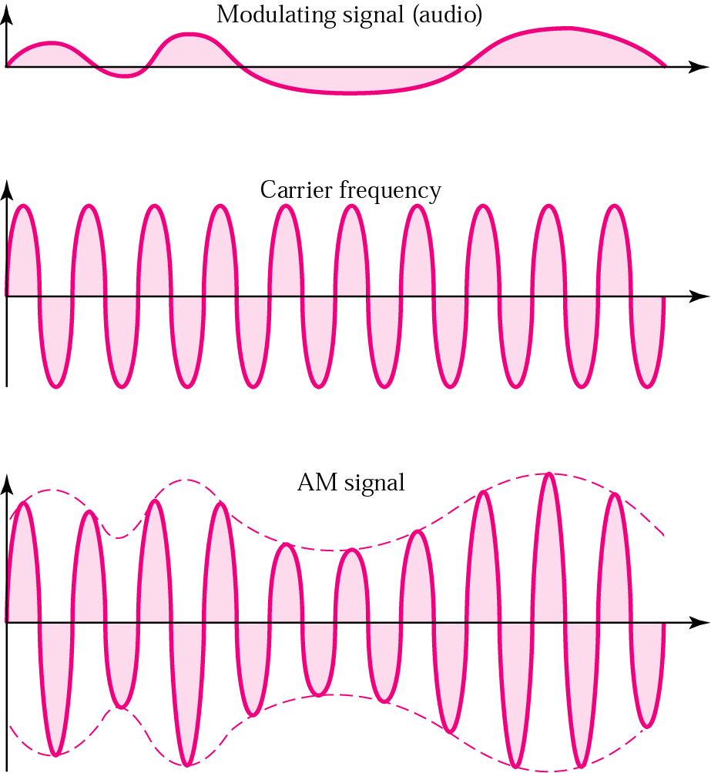
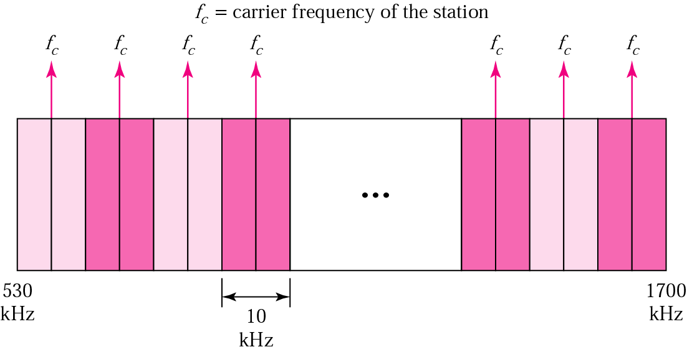
Analog Modulation: AM
AM Radio
  One carrier one radio channel
  Each channel requires 10 KHz
  Frequency range 530 KHz to 1700 KHz

Slide 6
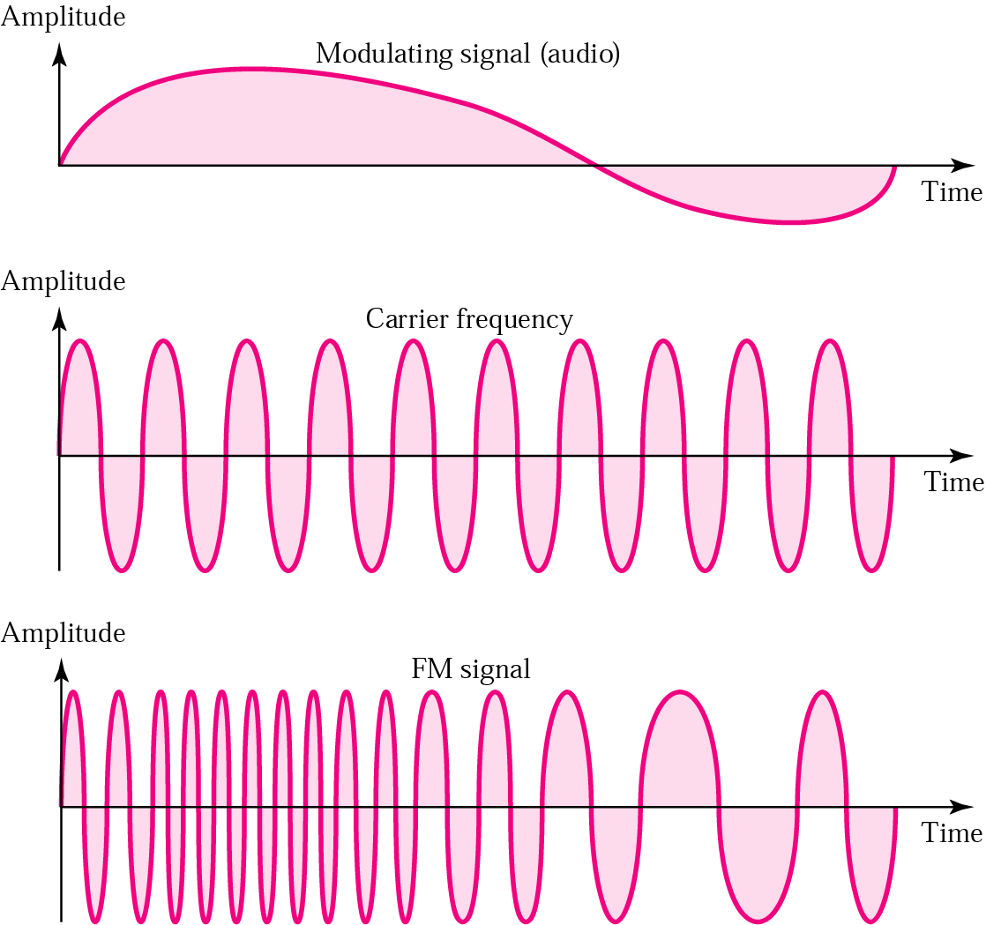
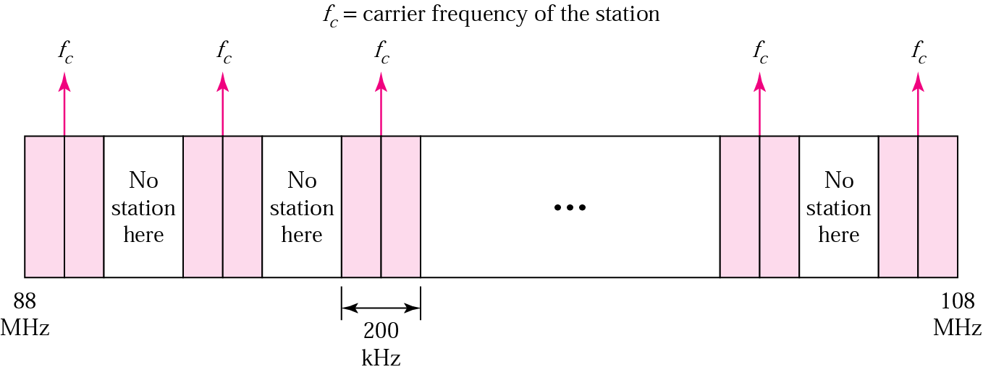
Analog Modulation: FM
FM Radio
  One carrier one radio channel
  Each channel required 200 KHz
  Frequency range 88 MHz to 108 MHz
Notes:
Better noise immunity than AM

Slide 7
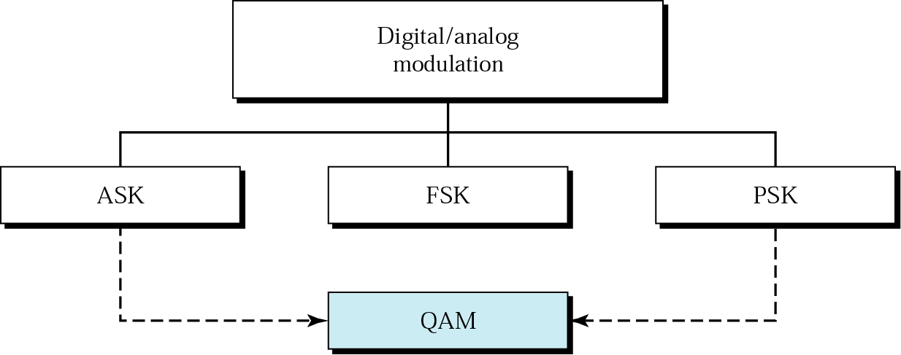
Digital Modulation

Slide 8
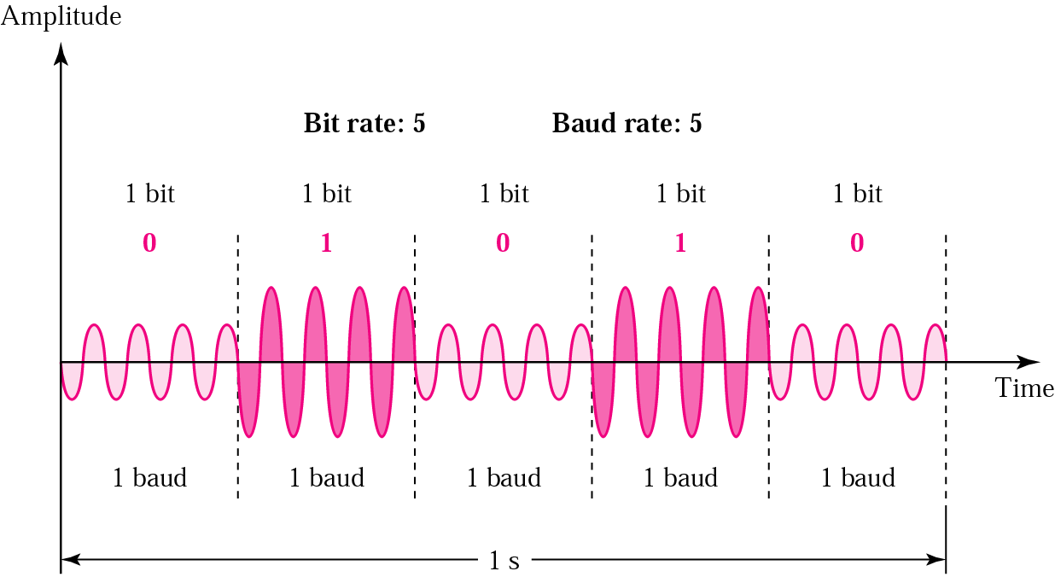
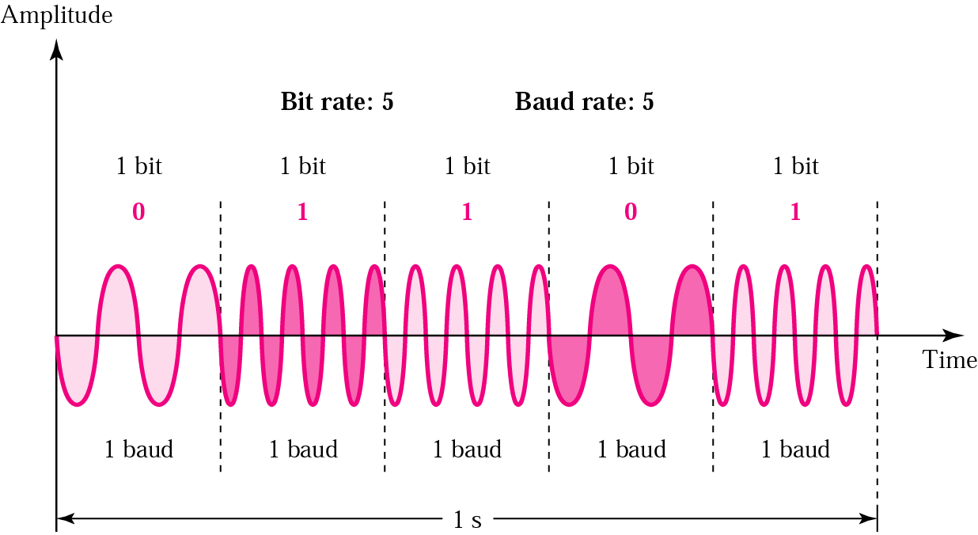
Modulation: B-ASK and B-FSK

Slide 9
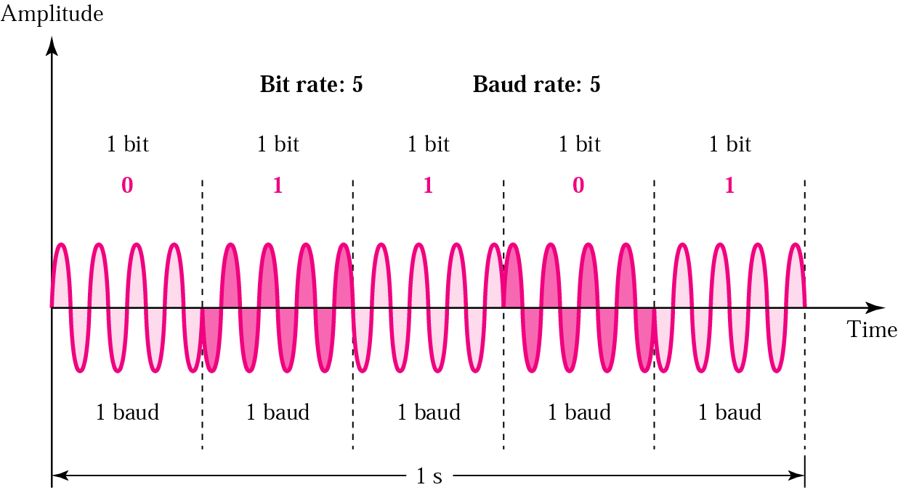
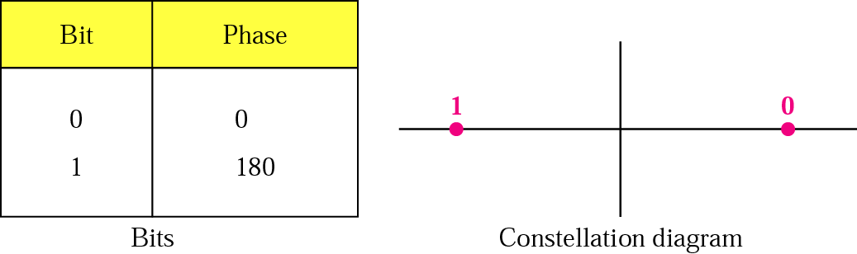
Modulation: B-PSK

Slide 10
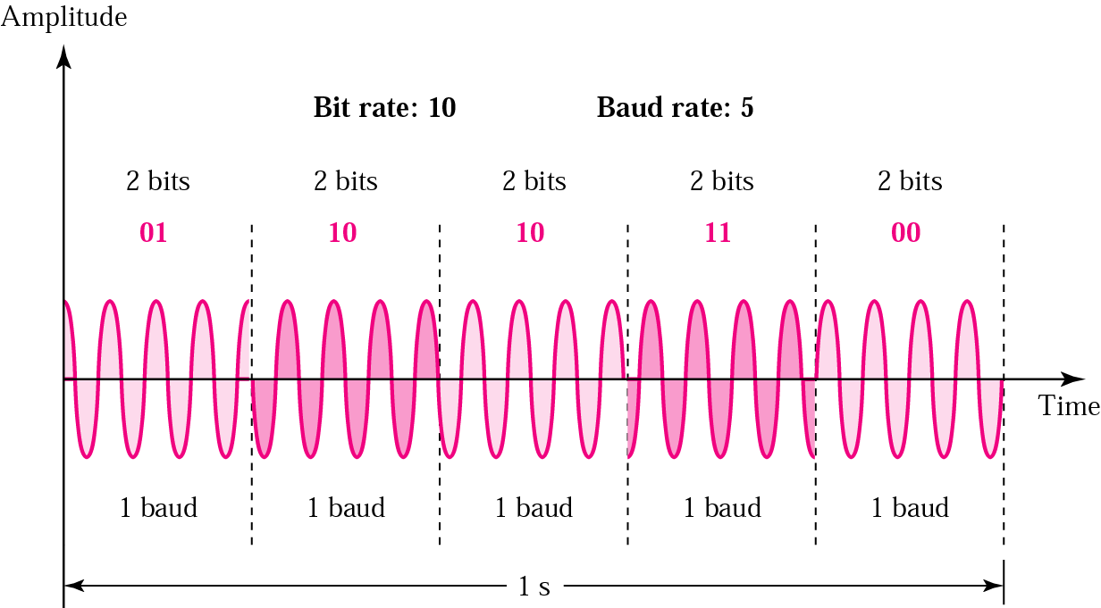
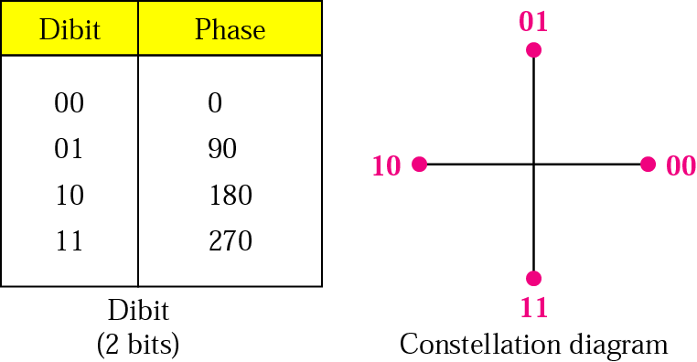
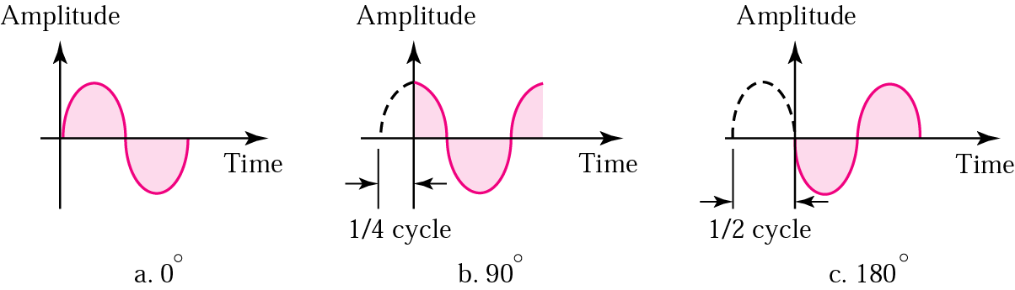
Modulation: QPSK

Slide 11
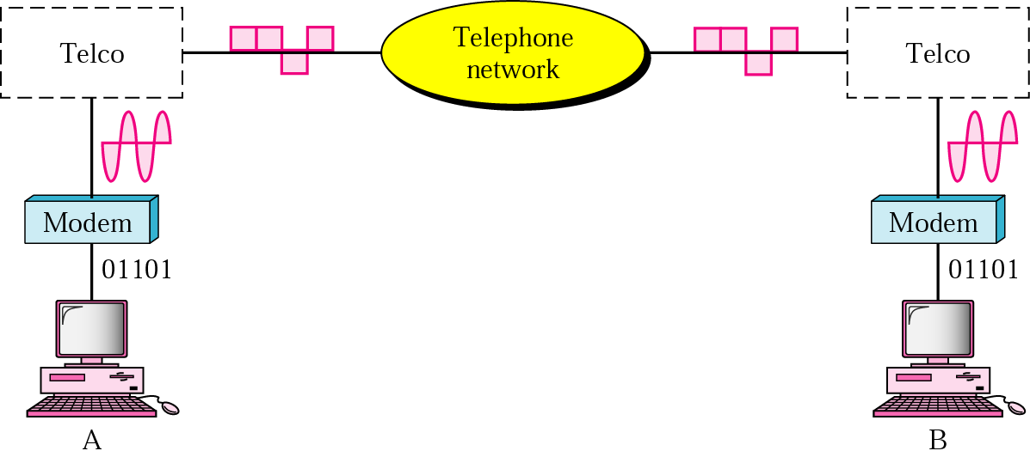
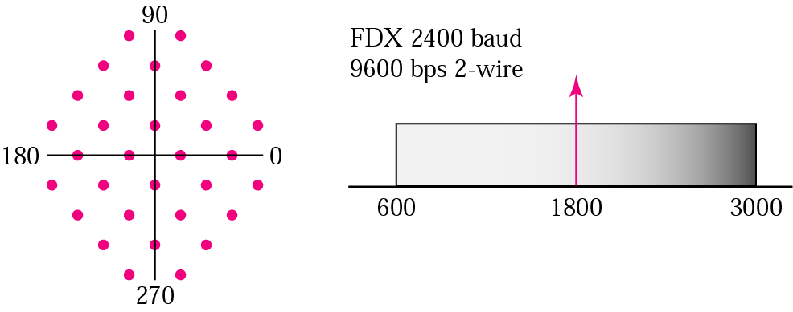
MODEM – MOdulator DEModulator

Slide 12
Summary
In this session, we have learned:
  The need and process of modulation/demodulation
  Difference between analogue and digital modulation techniques
  Analogue modulation techniques such as AM, FM along with applications
  Digital modulation techniques called ASK, FSK and PSK and their variants along with applications
  Functionality of MODEM

Slide 13
Thank You

